Slide 1


VIRTUAL INTERNSHIP AT
NAME - SHIVAM ARORA
BRANCH - ECE (MORNING)
ENROLLMENT NUMBER - 20915002822
ROLL NUMBER - 60

Slide 2
INTRODUCTION
Task 1: Web scraping to gain company insights
What l learnt
• How data scientists at British Airways apply analytical skills to make tangible impact by providing recommendations, tools, and models that drive key business decisions
What I Did
• Scrape and collect customer feedback by analysing third-party data
• Present your insights in using PowerPoint

Slide 3
Task 2: Predicting customer buying behaviour
What l learnt
• How using data and predictive models helps British Airways acquire customers before they embark on their holidays
What I Did
• Prepare a dataset
• Train a machine learning model
• Evaluate and present your findings

Slide 4
Task 1: Web scraping to gain company insights

Slide 5
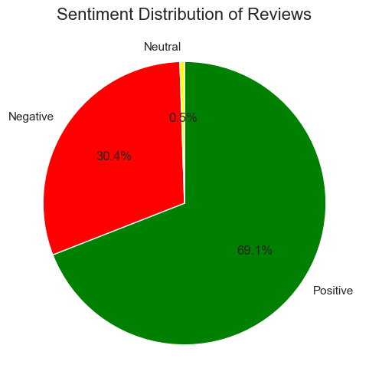
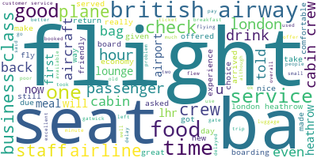
INSIGHTS FROM CUSTOMER REVIEWS
From cleaning 3850 reviews given by the customers on Skytrax , we obtained : Positive Reviews – 69.1% Negative Reviews – 30.4 % Neutral Reviews – 0.5%

Slide 6
Task 2: Predicting customer buying behaviour

Slide 7
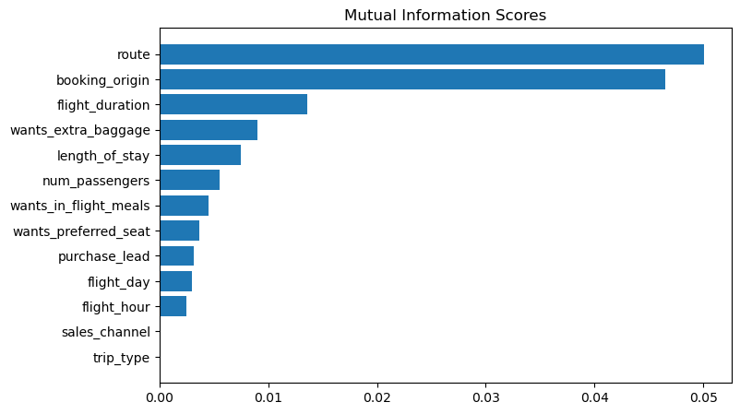
Predictive model to understand factors that influence buying behaviour
We have trained the data set with Random forest classifier model and received
ACCURACY: 85.09
AUC score: 0.5578
route
booking_origin
flight_duration
wants_extra_baggage
length_of_stay
are the top 5 features which influence
Customer buying behavior

